Slide 1

All you need to know to get started with Relational Databases
Wladymir Brborich

Slide 2
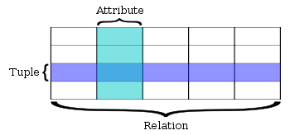
What is a relational database?
It is a database based on the relational model of data, the more you know…
Stores data as a set of tables, which can be related to each other
Each record has a primary key identifier and is stored as a row on a table

Slide 3
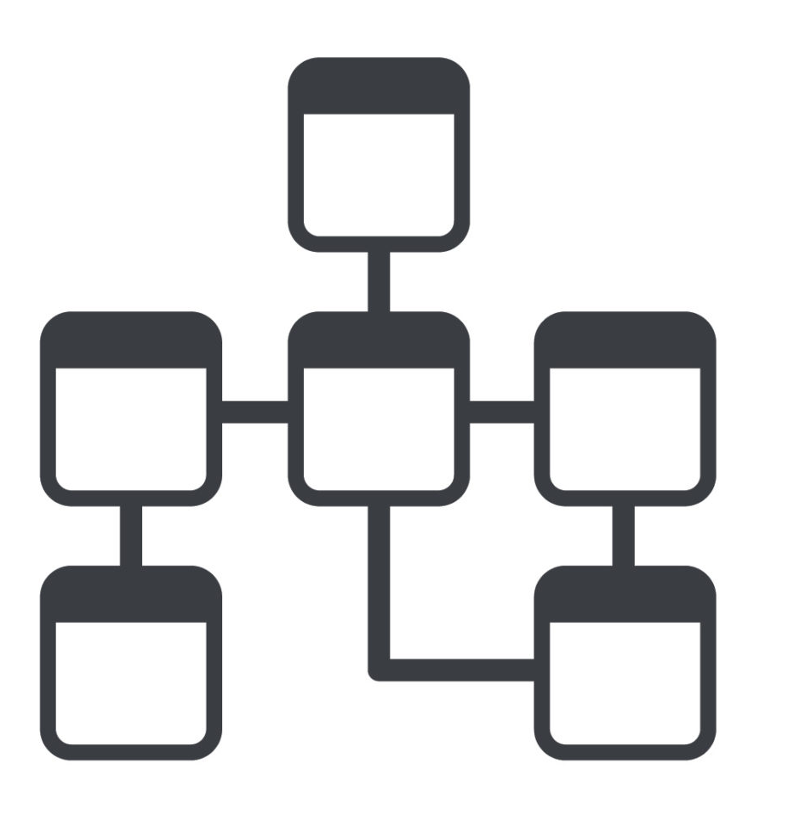
Table relationships
Tables can be related to each other, to accommodate the needs of your system, there are two main types of relationships:
One to many
Many to many
You can think of them as links between data

Slide 4
One to Many Relationships
When a record on a specific table can be related to many records on other table.

Slide 5
Many to Many Relationships
When many records on the same table could be related to many records on other table
It creates an intermediate entity

Slide 6
Querying data
Read Operations like select
Manipulation Operations, like update, delete and insert
You need to think in terms of records, not in terms of variables
Example Queries:
Select {columns} from {table} where {condition} {ordering or grouping function}
Insert {record} into {table}
Delete from {table} where {condition}
Update {table}{parameters} where {condition}

